Slide 1
Cleaning Data
Sean McMinn
Digital frameworks
Northwestern University – Summer 2018
Github.com/shmcminn/digitalframeworks-summer18

Slide 2
Data stories?

Slide 3
Steps to a data story
Find data
Clean data
Analyze data
Present data

Slide 4
Agenda
Five cleaning activities done with partners
Advanced cleaning techniques using Sublime Text and Excel

Slide 5
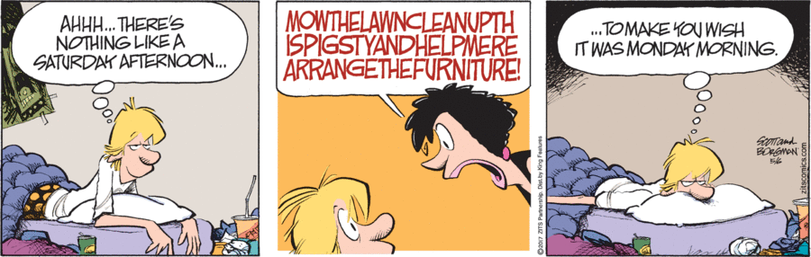
Data cleaning

Slide 6
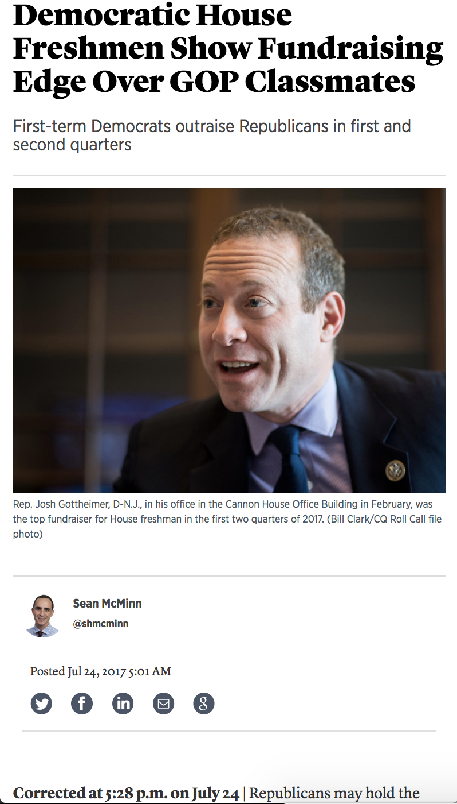
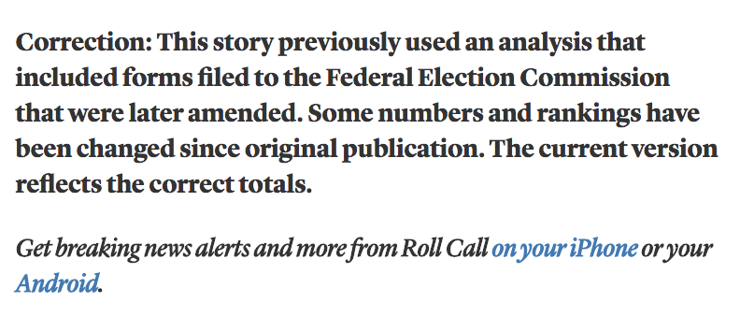
Data cleaning
Prevents this

Slide 7
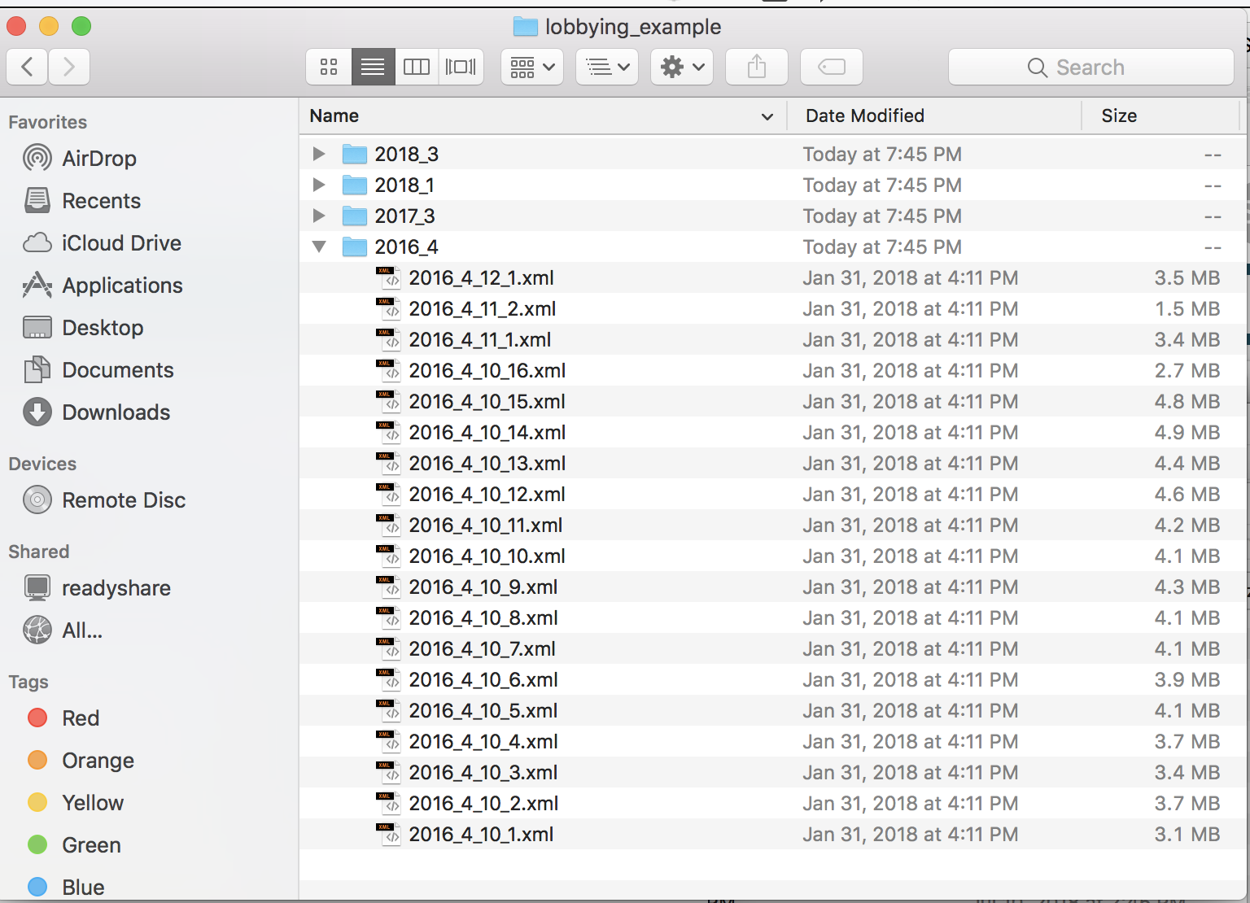
Data cleaning
And let’s you turn this

Slide 8
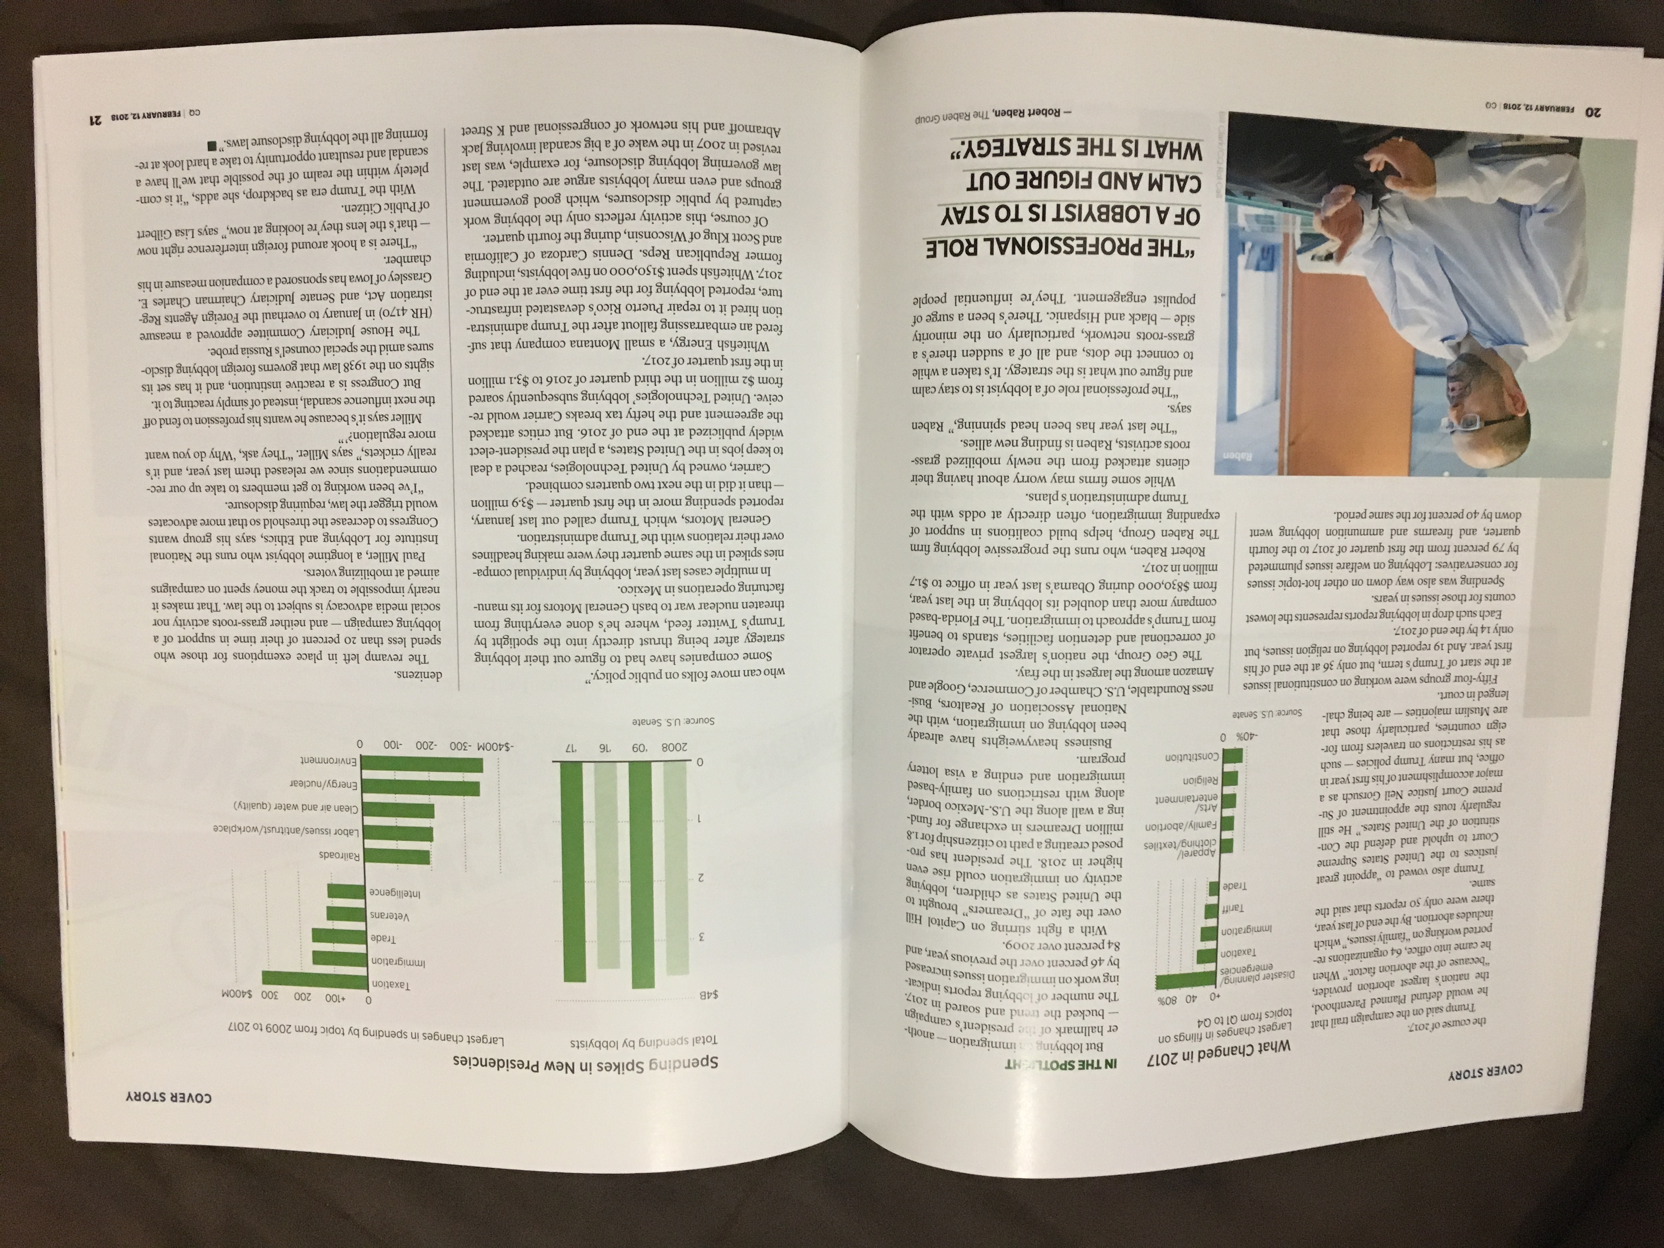
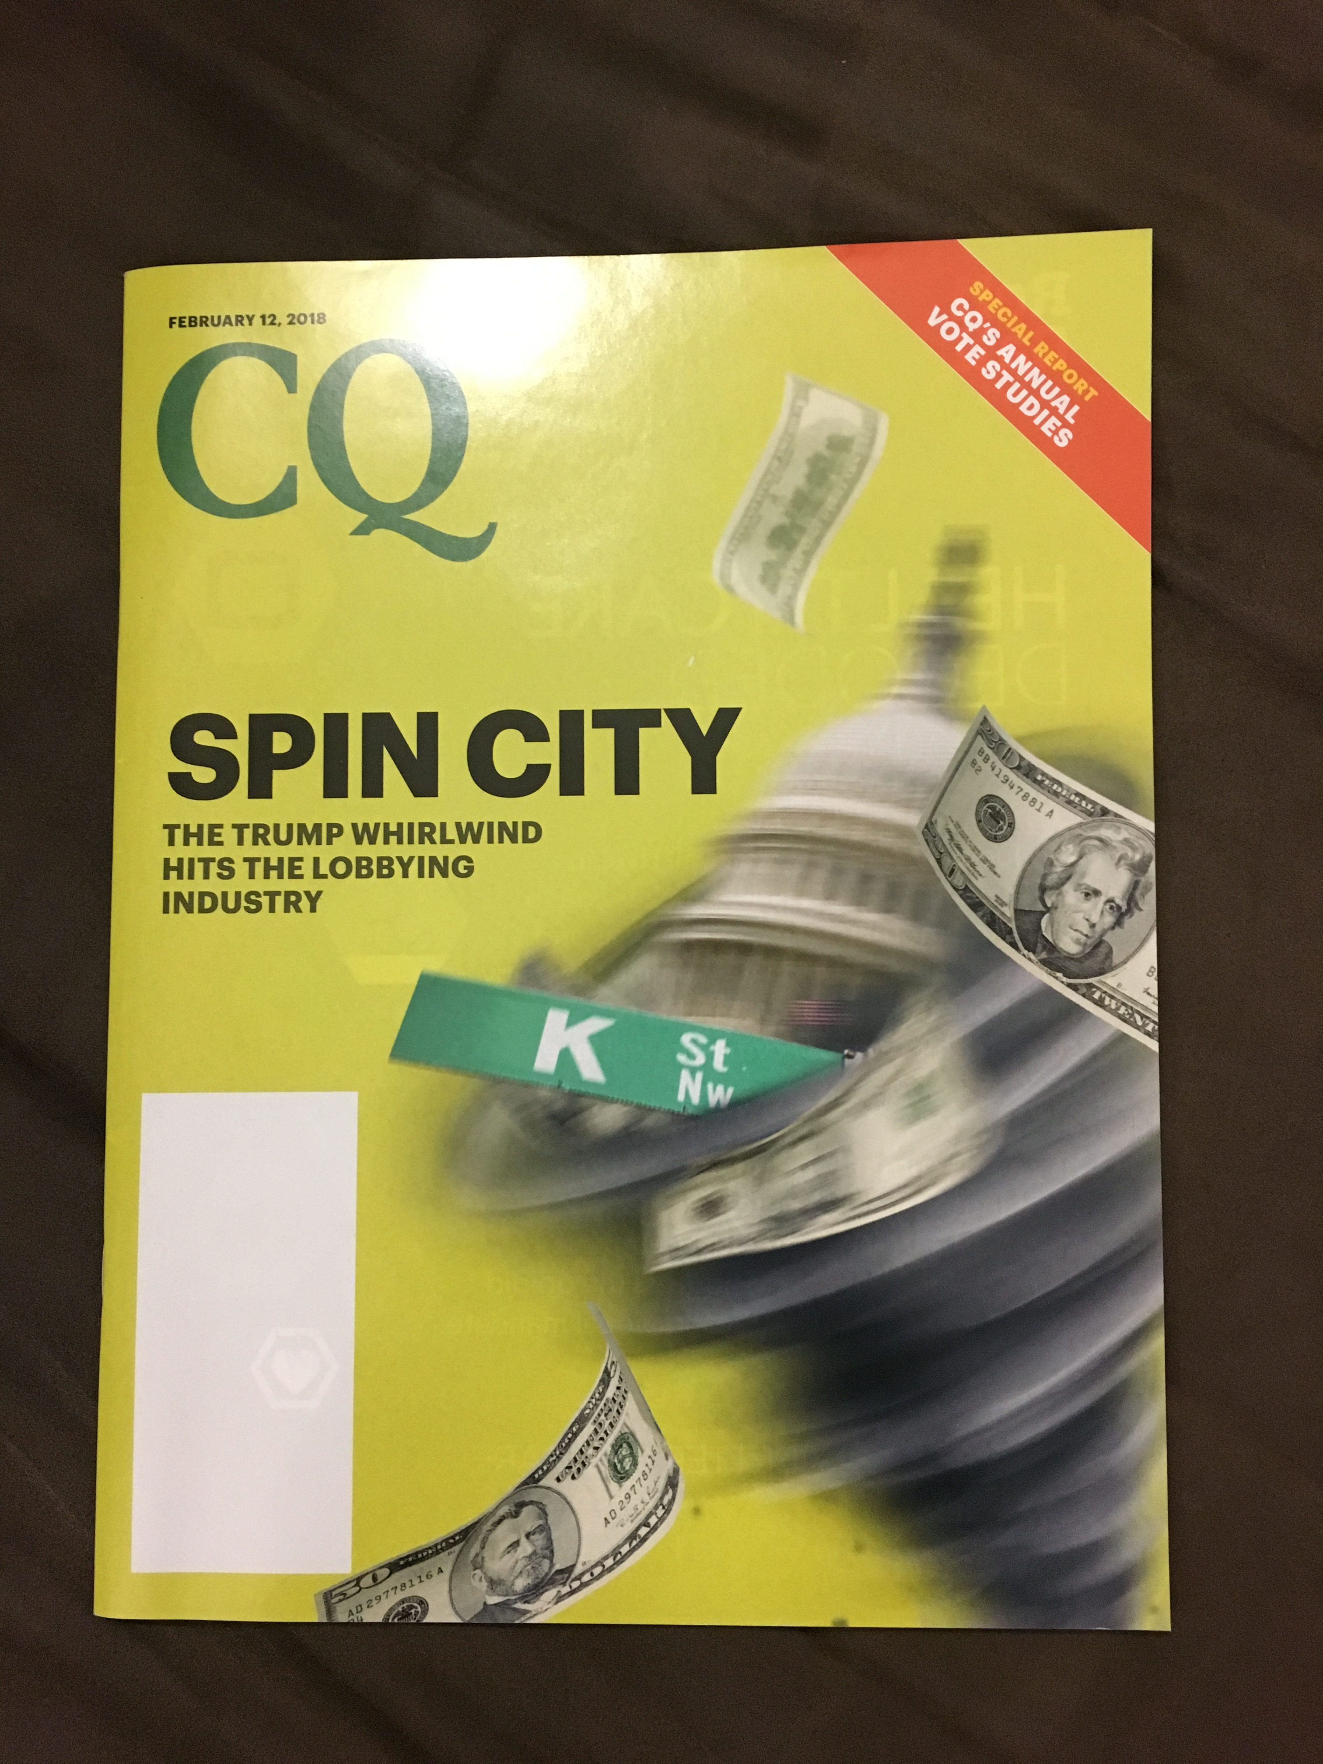
Data cleaning
Into this

Slide 9
Data cleaning
Example of how it can screw you up when data isn’t correctly set up to be machine readable

Slide 10
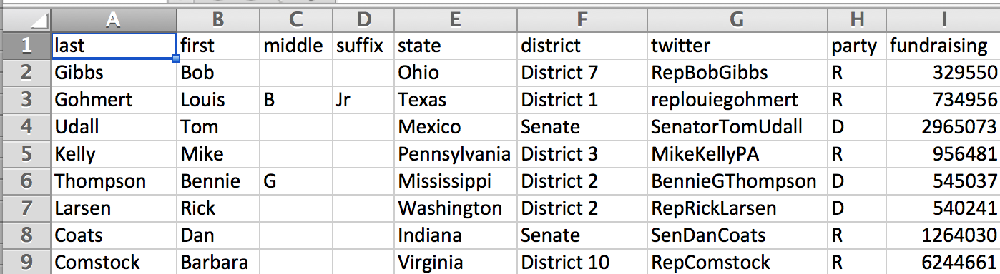
Data examples
“Good” (slash very fake) fundraising data

Slide 11
Data examples
“Good” (slash very fake) fundraising data
Separate fields in separate columns

Slide 12
Data examples
“Good” (slash very fake) fundraising data
Separate fields in separate columns
States and districts formatted the same

Slide 13
Data examples
“Good” (slash very fake) fundraising data
Clean numbers (no commas, $ signs)
Separate fields in separate columns
States and districts formatted the same

Slide 14
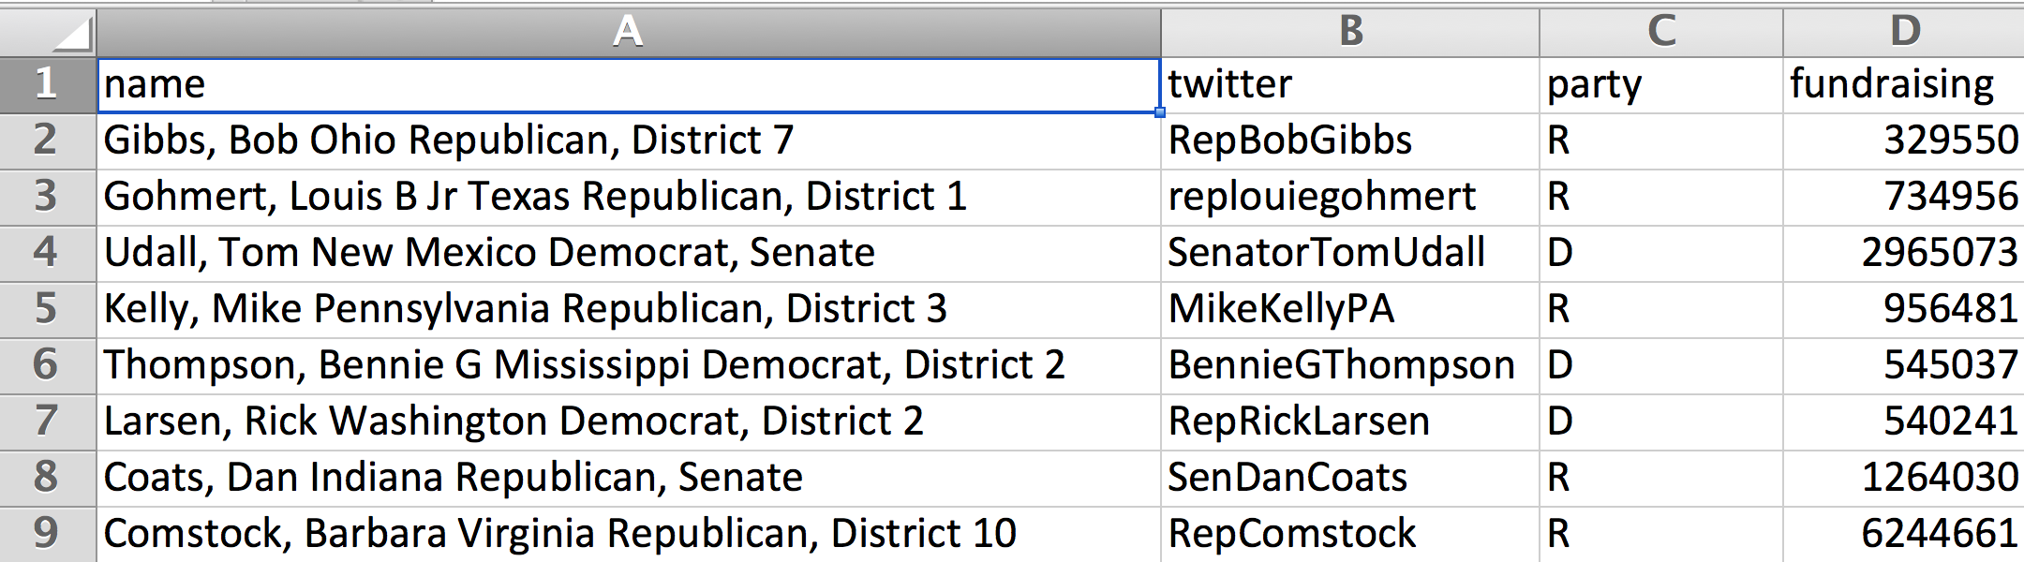
Data examples
How that data started out
Lots mashed together for each data point
Redundant column

Slide 15
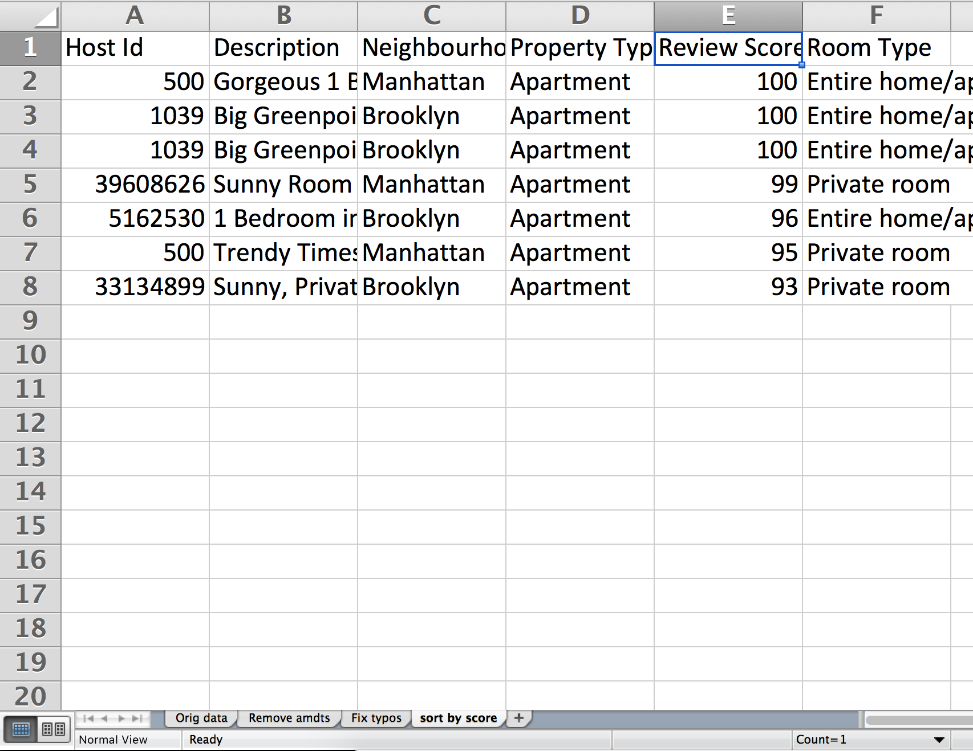
First, a word
Always work on a COPY of your data!
Always keep a RECORD of what you’re doing to your data
Example:

Slide 16

First, a word
Always work on a COPY of your data!
Always keep a RECORD of what you’re doing to your data
Example:

Slide 17
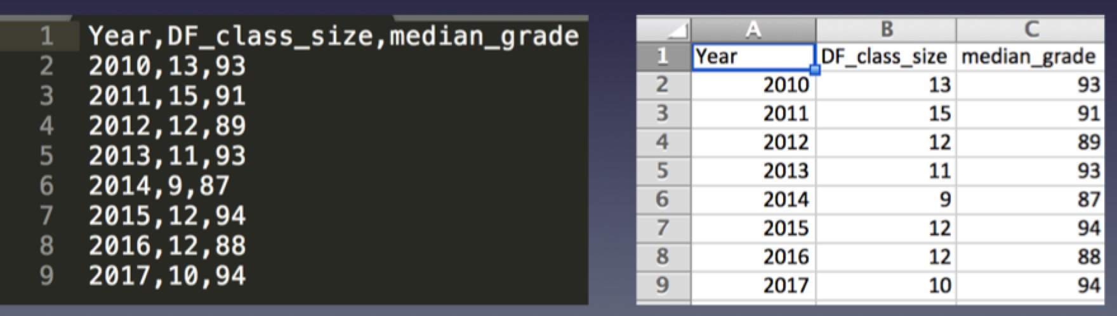
CSV => Excel
Excel can interpret CSV files very well! Sometimes.
This is going to focus on spreadsheets, but many of the same principles apply to other data formats

Slide 18
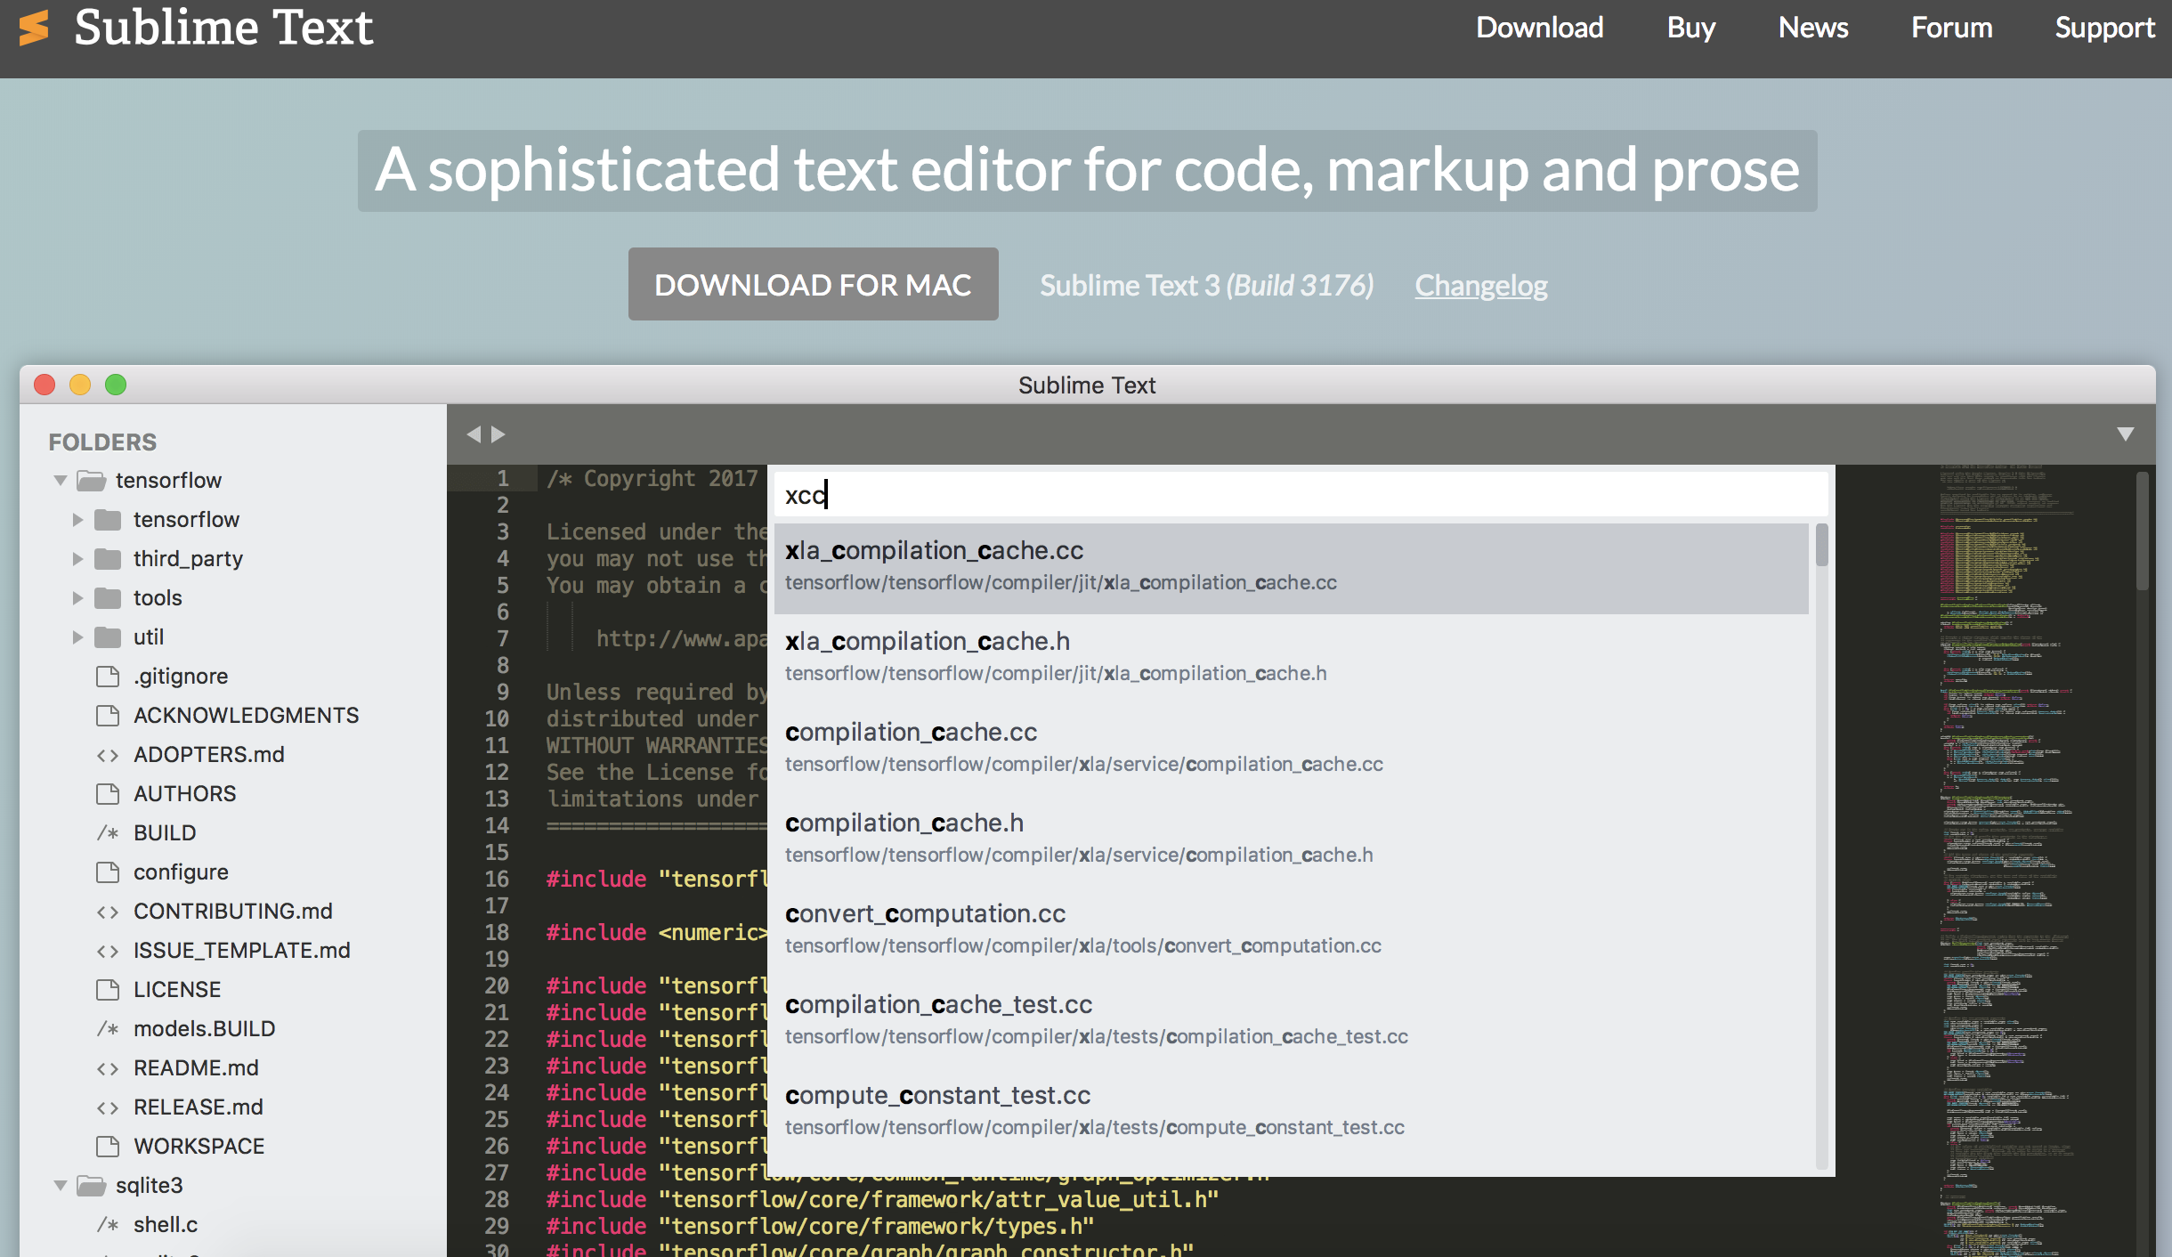
First …
Download text editor
sublimetext.com/3

Slide 19
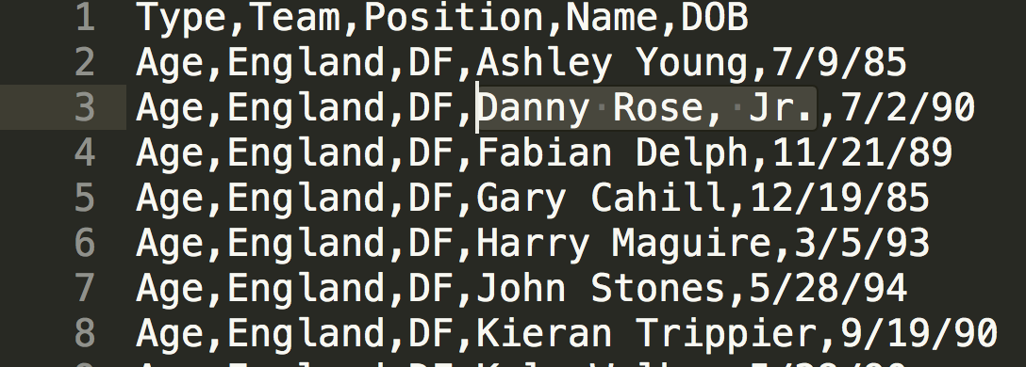
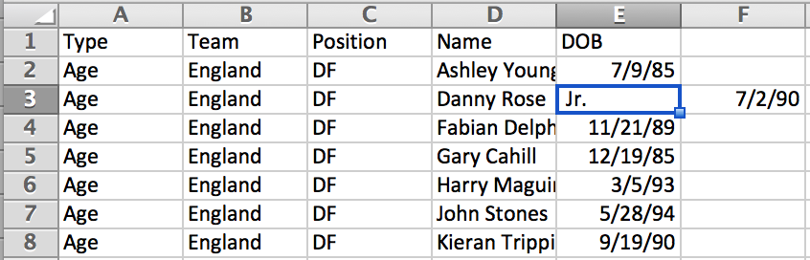
What to watch out for
Extra comma
(not actually a Jr.)
¯\_(ツ)_/¯

Slide 20
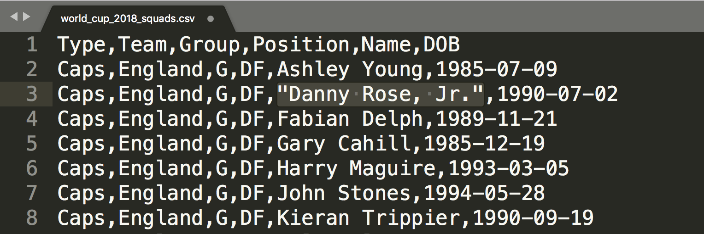
What to watch out for
Fix with quotes

Slide 21
What to watch out for
In pairs, fix this spreadsheet
Airbnb-comma.csv

Slide 22
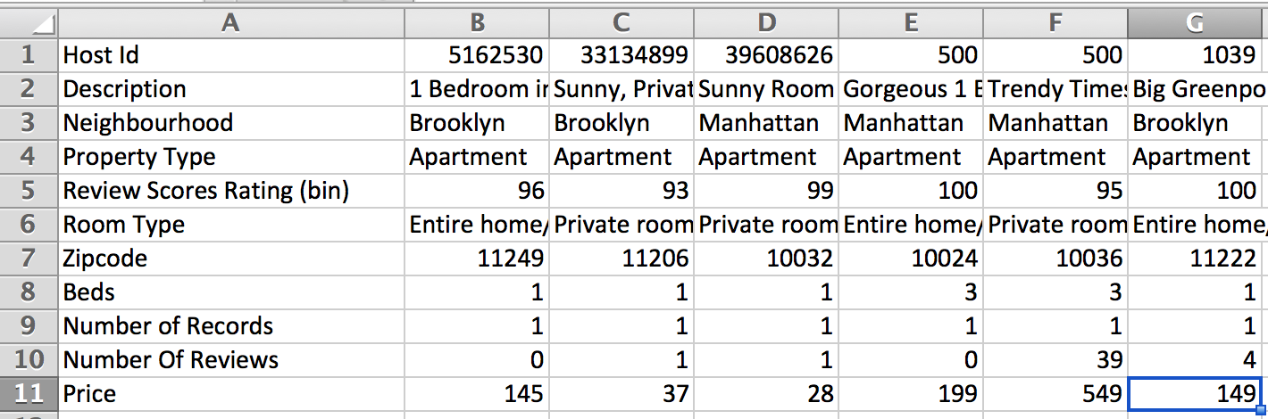
What to watch out for
Wrong-way (aka “fat”) data

Slide 23
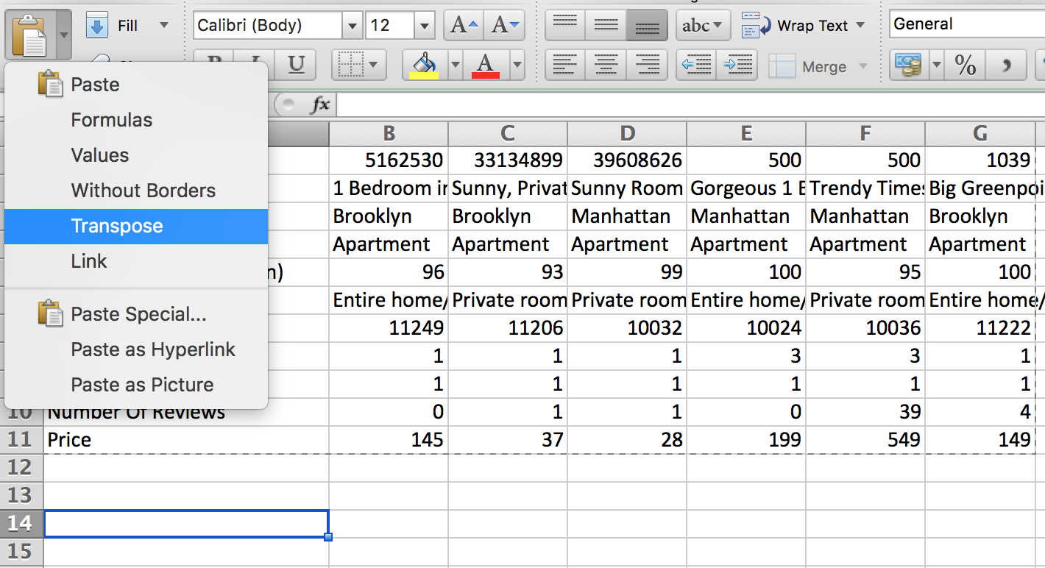
What to watch out for
Fix: Copy + Paste (transpose)

Slide 24
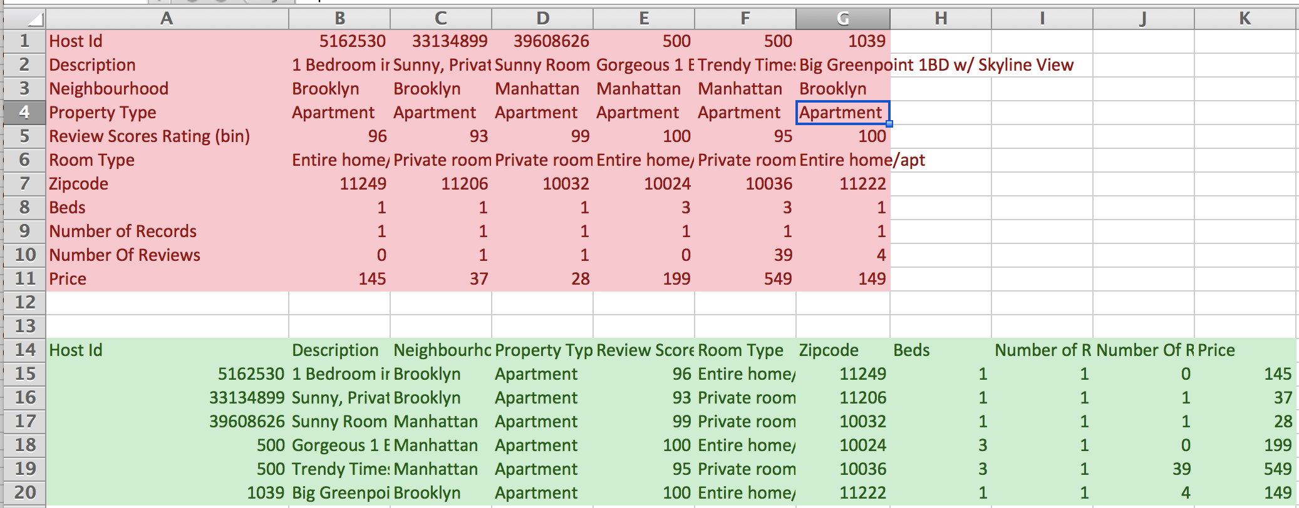
What to watch out for
Much better

Slide 25
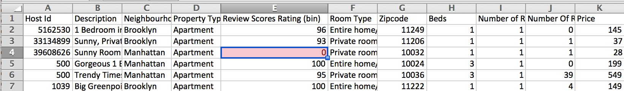
What to watch out for
Missing data
People will sometimes just BS what goes in there

Slide 26
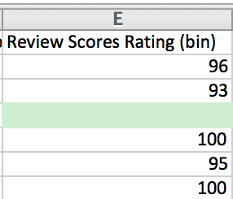
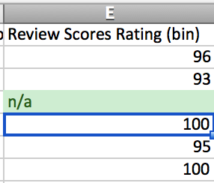
What to watch out for
Fix: Empty or put in missing indicator

Slide 27
What to watch out for
In pairs, clean this data
Airbnb-transpose-missing.csv

Slide 28
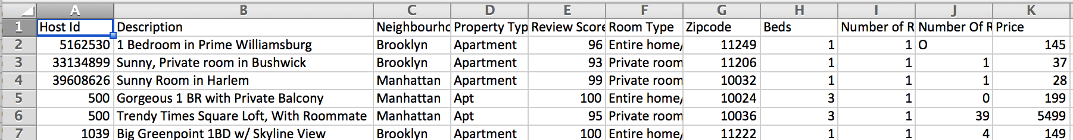
What to watch out for
Typos and/or data input inconsistency

Slide 29
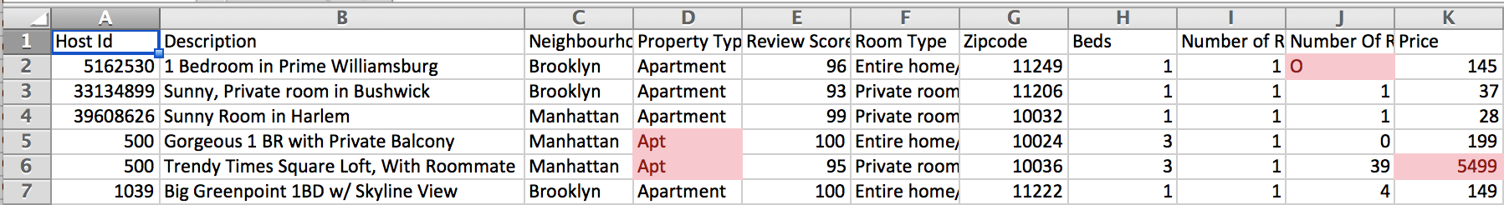
What to watch out for
Crazy outliers
Different formatting (letter O vs # 0)

Slide 30
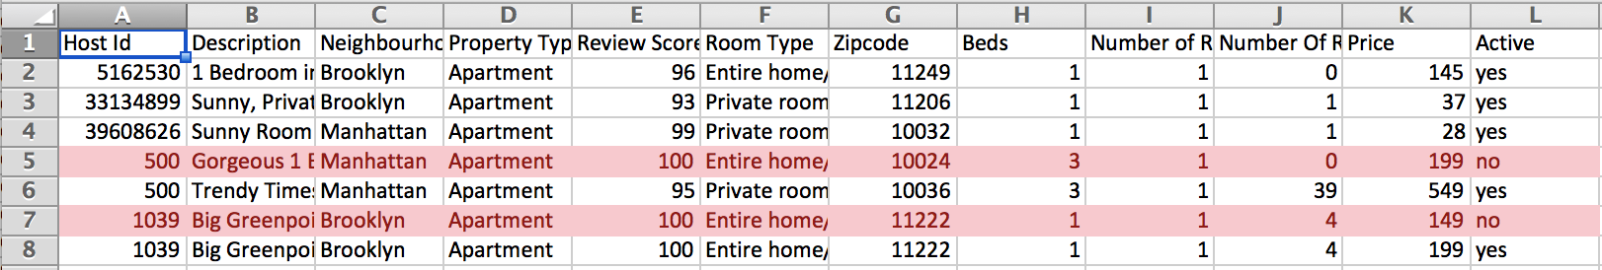
What to watch out for
Duplicates/amendments

Slide 31
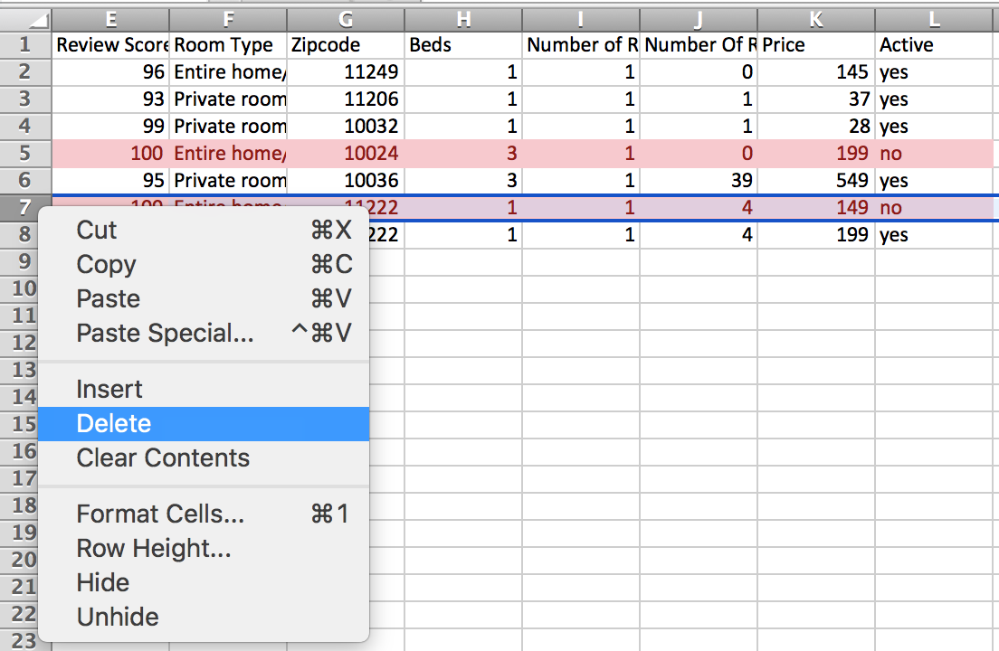
What to watch out for
Delete whole row by right clicking on row number

Slide 32
What to watch out for
In pairs, clean this data
airbnb-typos-amndmts.csv

Slide 33
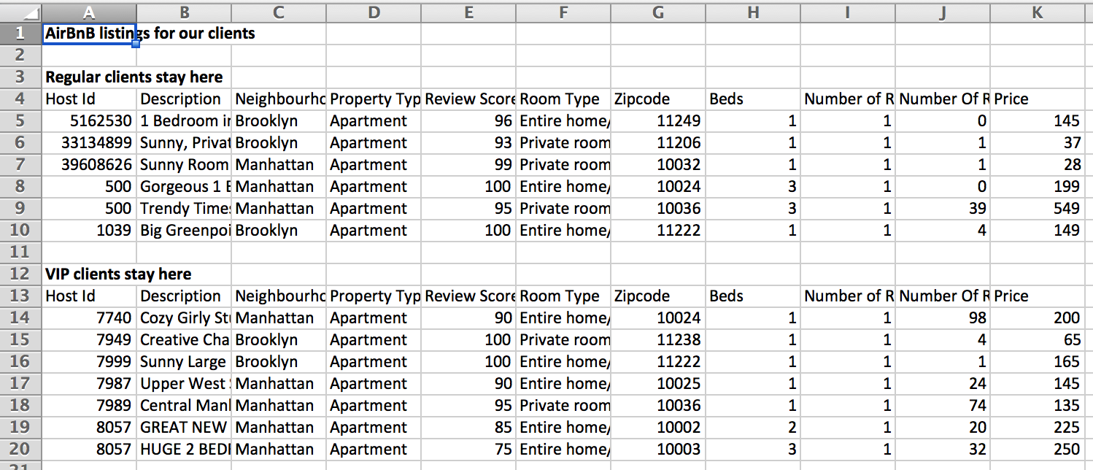
What to watch out for
Data broken into sections

Slide 34
What to watch out for
No need for title up top
Don’t want two headers
If groupings are important, add one (or more) data column(s)!

Slide 35
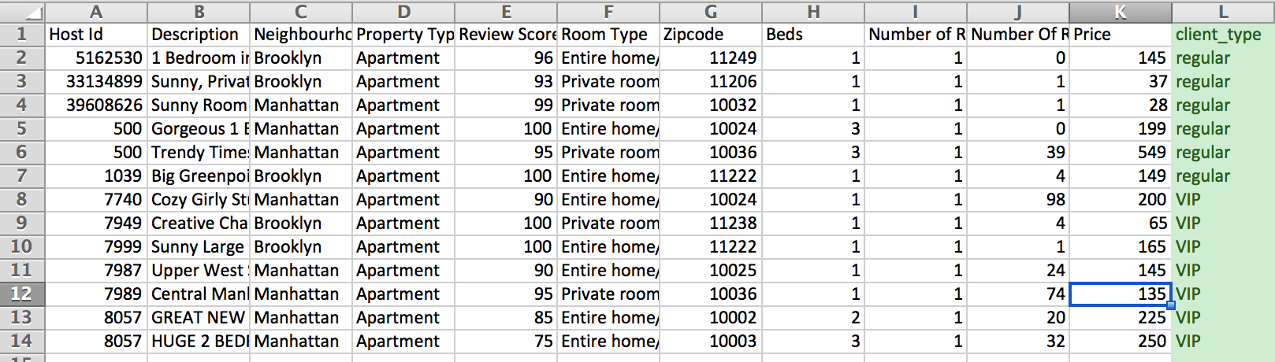
What to watch out for
Better ☺

Slide 36
What to watch out for
In pairs, clean this data
Airbnb-sections.csv

Slide 37
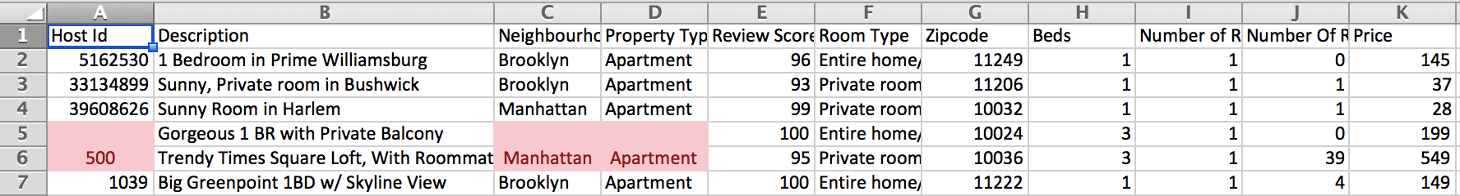
What to watch out for
Merged cells
People think they’re being ~*fancy*~
They’re not.

Slide 38
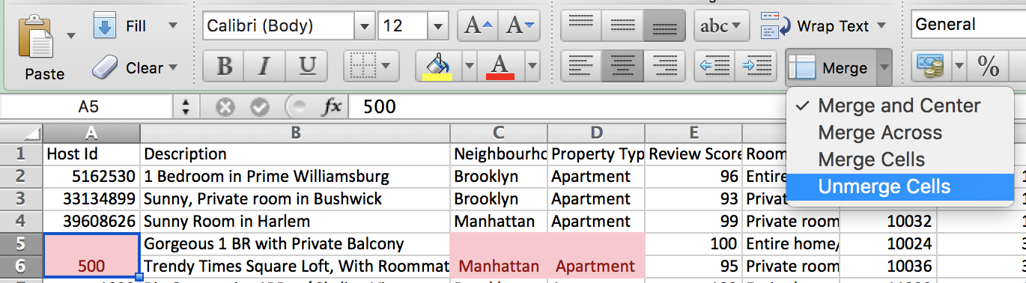
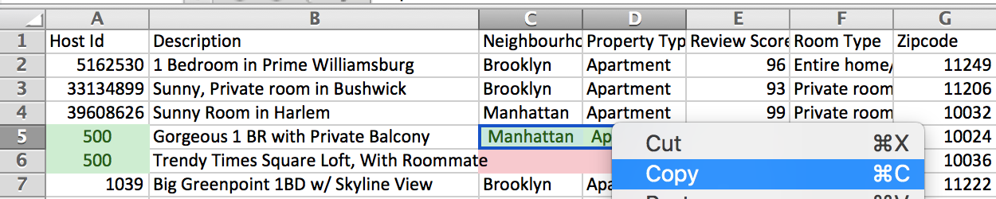
What to watch out for
Unmerge and copy the value to the blank cells

Slide 39
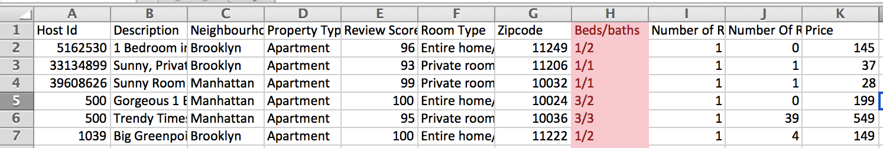
What to watch out for
Columns that should be split into two

Slide 40
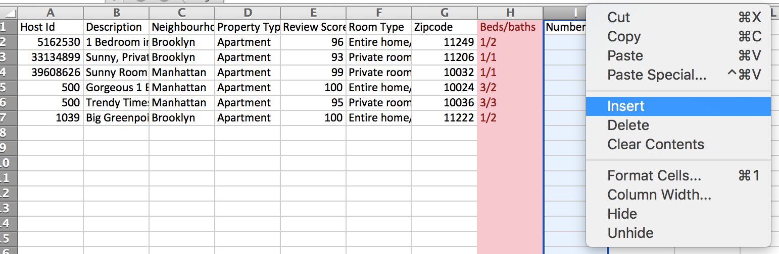
What to watch out for
Add a column next to it

Slide 41
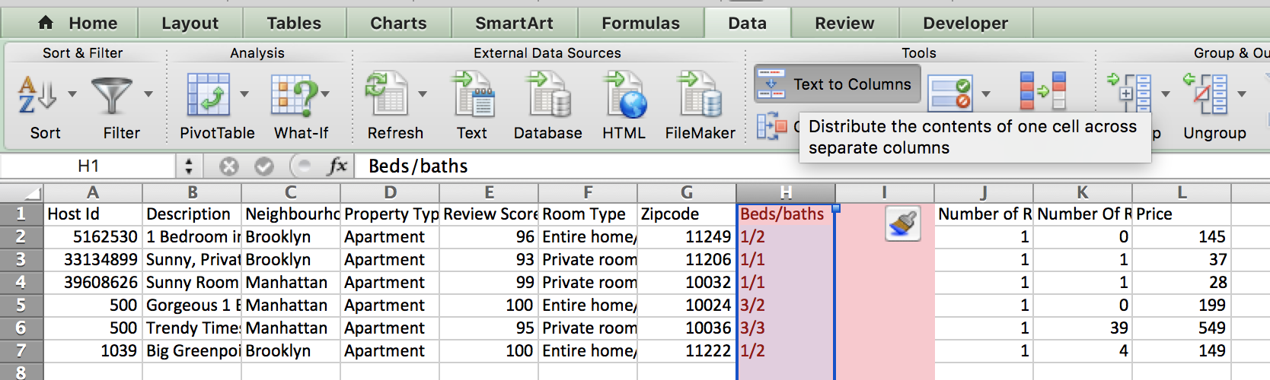
What to watch out for
Text to columns

Slide 42
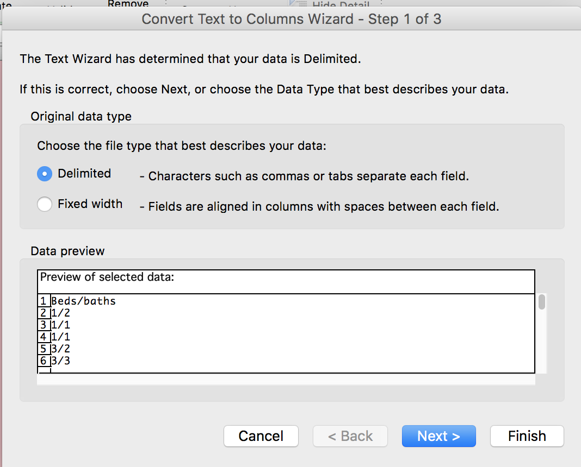
What to watch out for
Only works if data has a delimiter – something SEPARATING the data

Slide 43
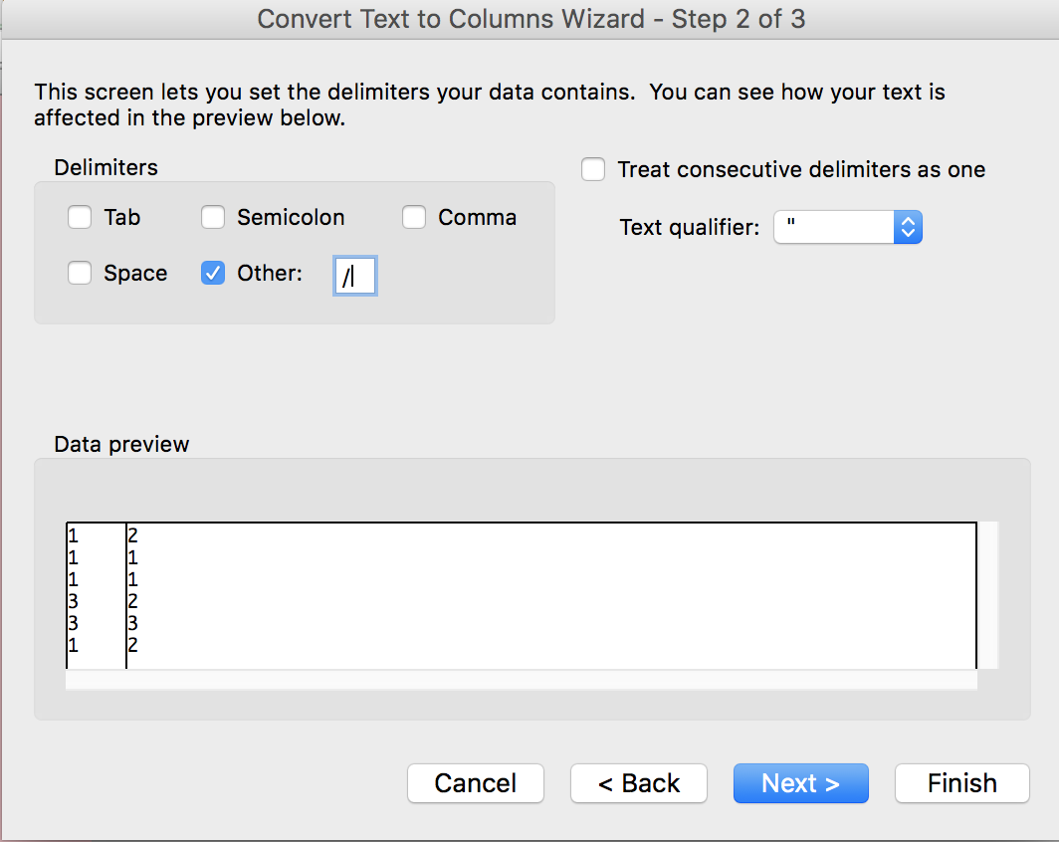
What to watch out for
Choose what your delimiter is

Slide 44
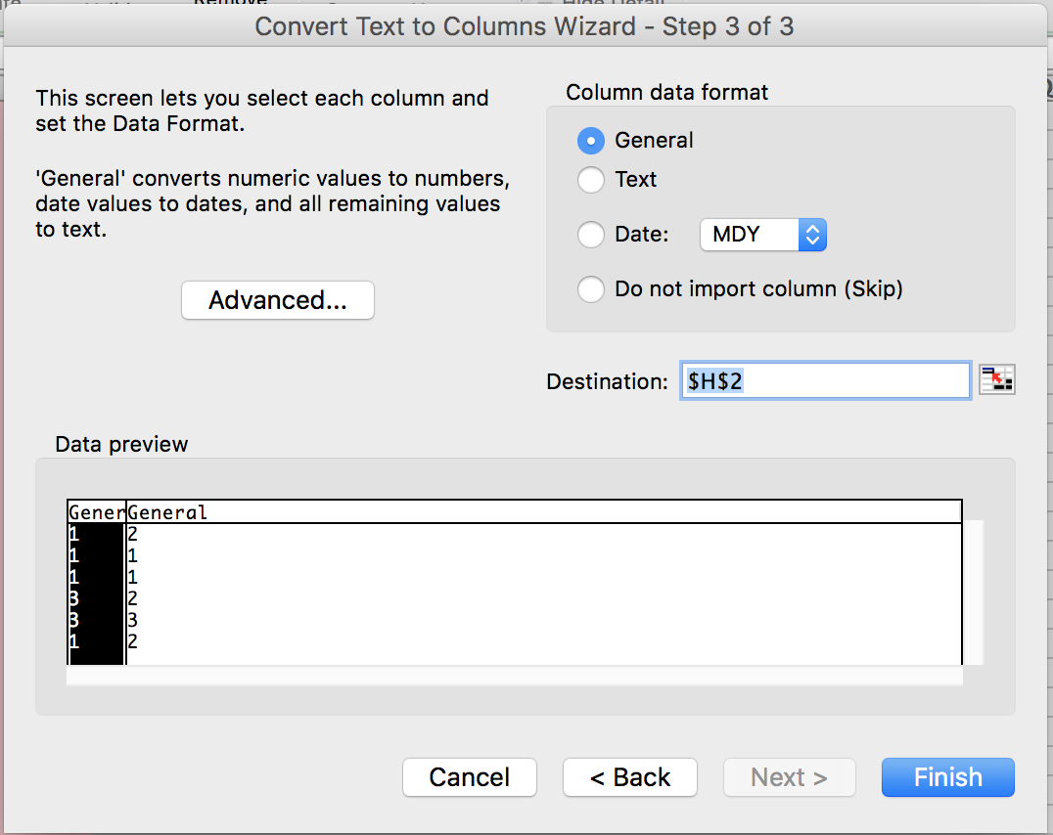
What to watch out for
Can leave this (puts data in same place)

Slide 45
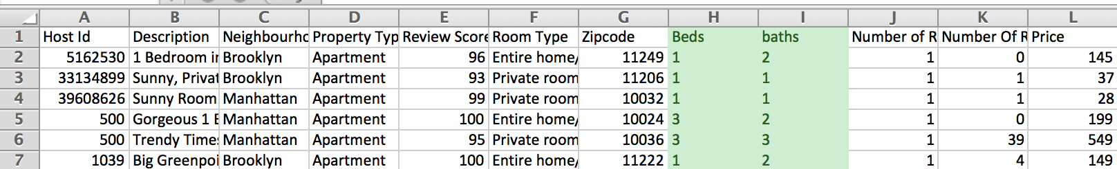
What to watch out for
Much better ☺

Slide 46
What to watch out for
In pairs, clean this data
Airbnb-cols.csv

Slide 47
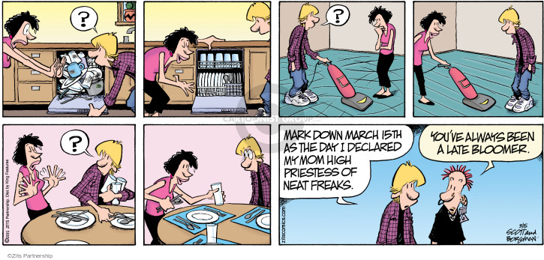
Cleaning techniques

Slide 48
Cleaning techniques
You can do everything by hand, one at a time, but UGH

Slide 49
Cleaning techniques
Select all blanks

Slide 50
Cleaning techniques
Filter then change

Slide 51
Cleaning techniques
Find and replace
{DOWNLOAD FILE}

Slide 52
Cleaning techniques
ADVANCED find and replace
a.k.a. regular expressions
a.k.a. regex
a.k.a. misleadingly intimidating garbage
^".*" or \n[A-Za-z]*\t or : "\d*"
{DOWNLOAD FILE}

Slide 53
Cleaning techniques
Find and replace in Sublime using regex

